Slide 1
OCR
Electrical equipment that scans characters (texts) from computer generated documents (e.g. printed, video-projected).
Optical character recognition

Slide 2
Two Different Types
Optical Character Recognition (OCR) - detects typewritten texts, one glyph or character at a time.
Intelligent Character Recognition (ICR) - detects handwritten texts, one glyph or character at a time.

Slide 3
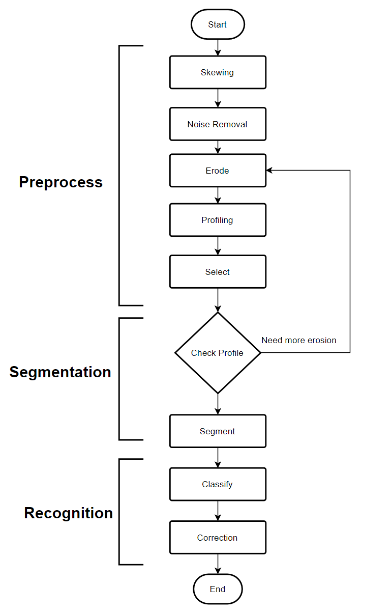
Flowchart to recognize characters in pictures

Slide 4
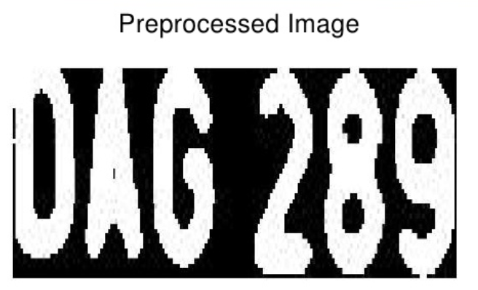
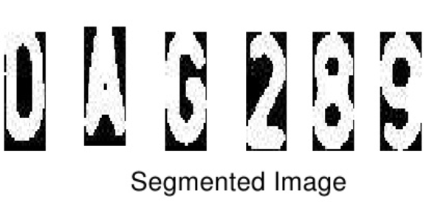
Preprocessing of Pictures

Slide 5
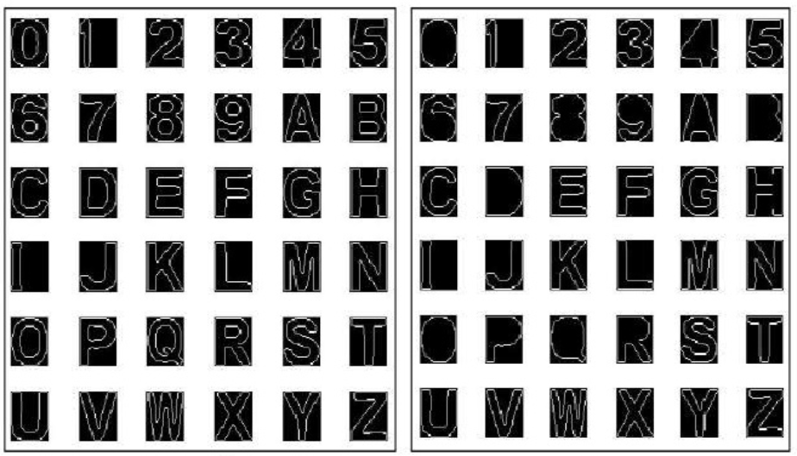
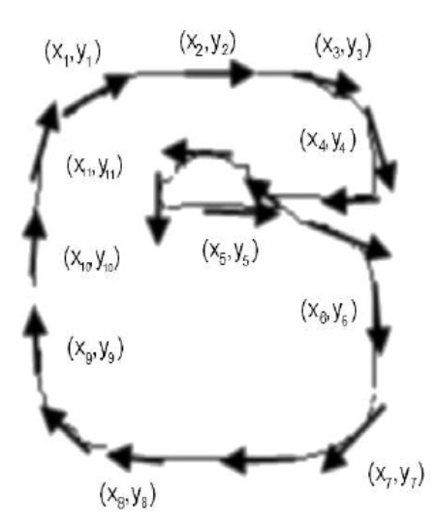
Pattern Recognition Using Edging

Slide 6
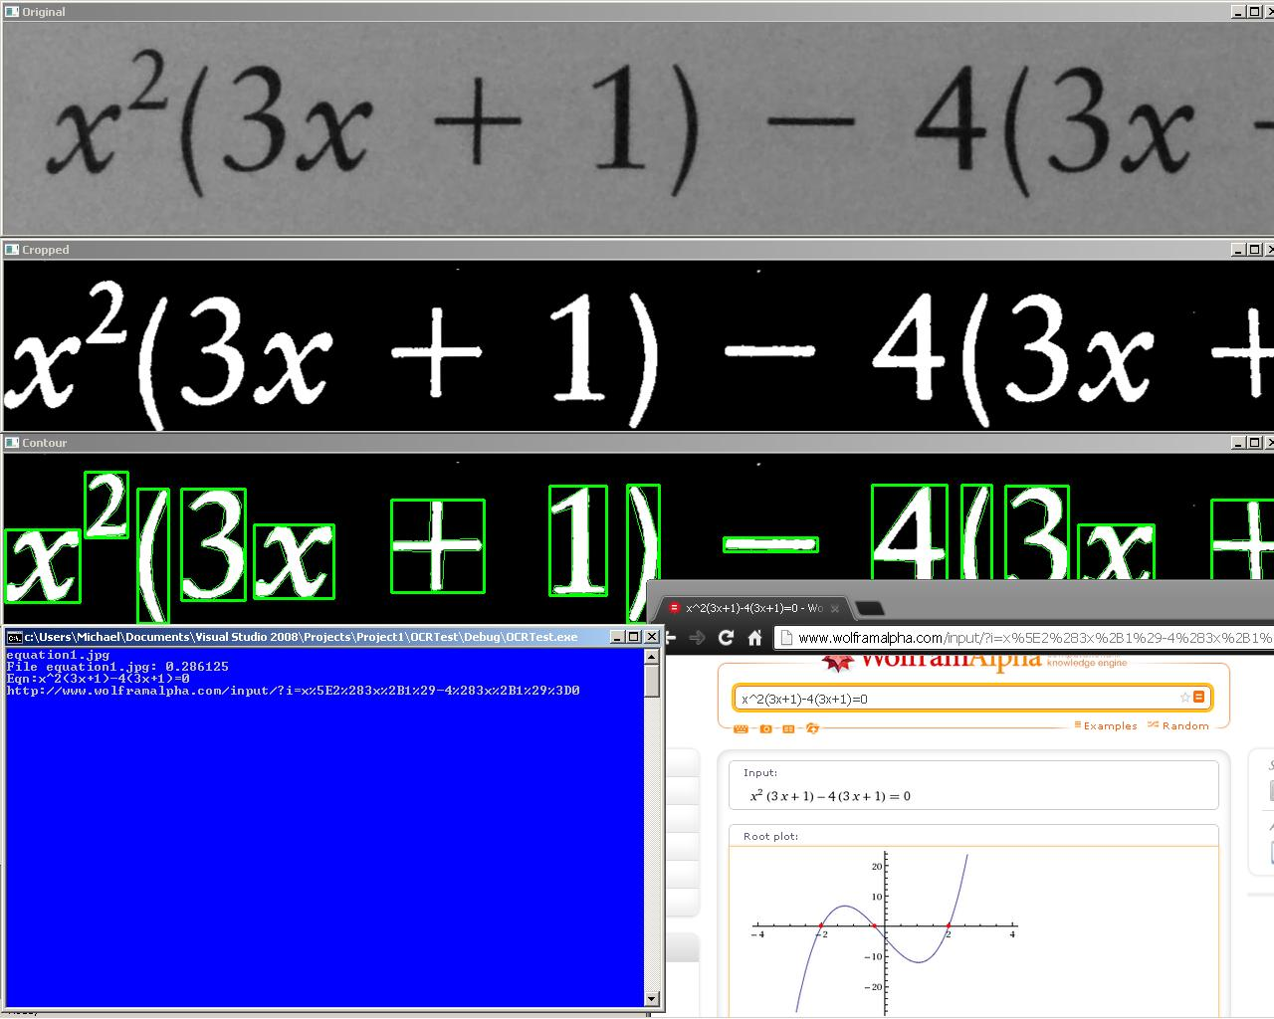
Example Result

Slide 7
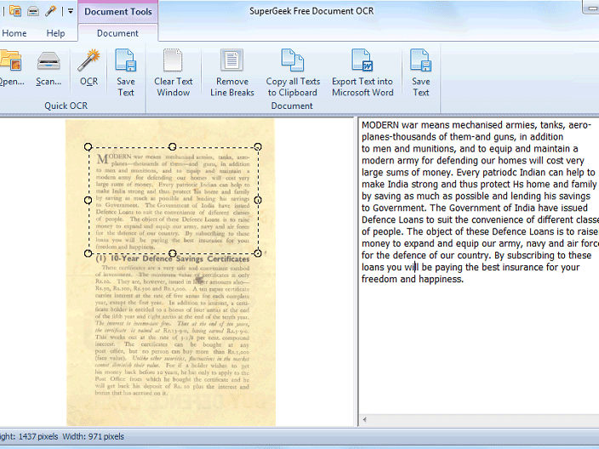
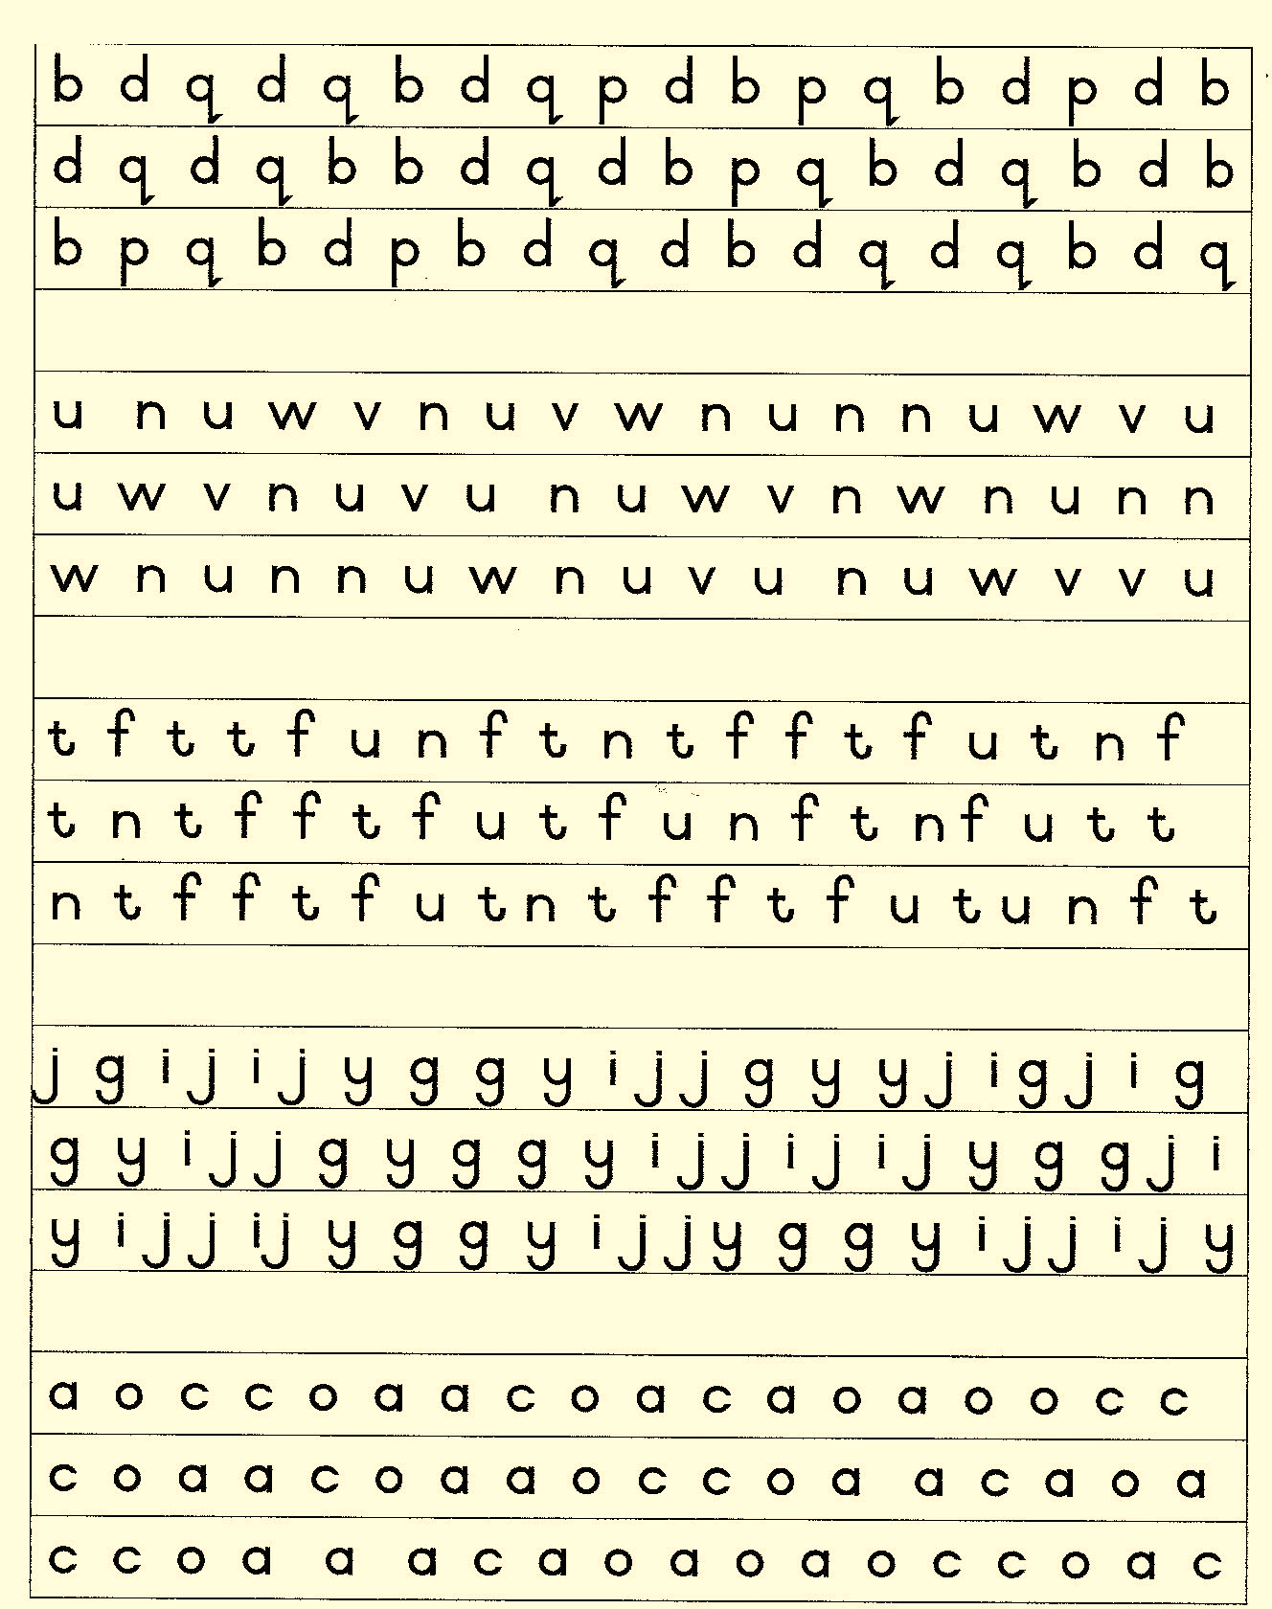
Post-Processing

Slide 8
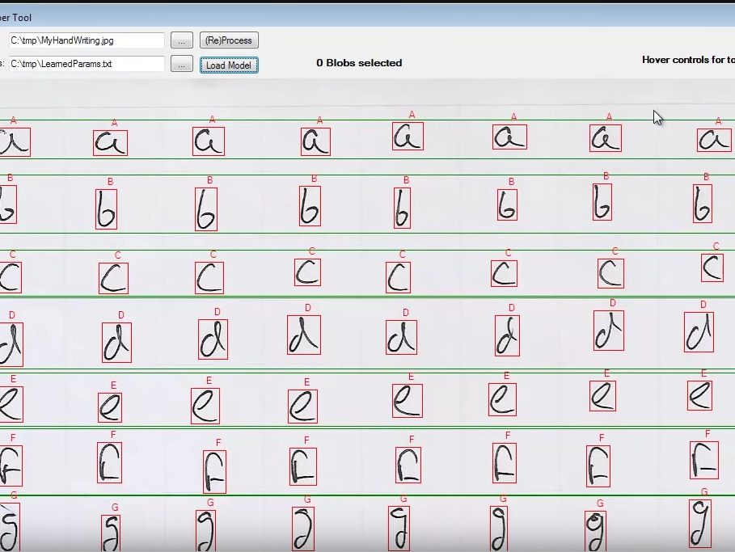
Training a OCR Software
Feeding it with datasets
Then training it against documents

Slide 9
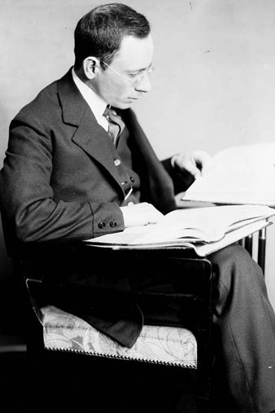
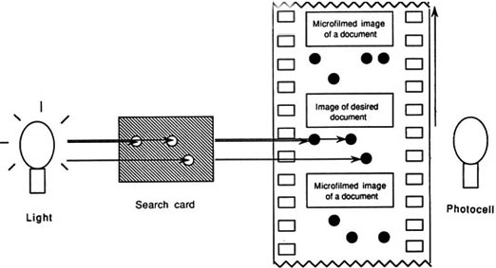
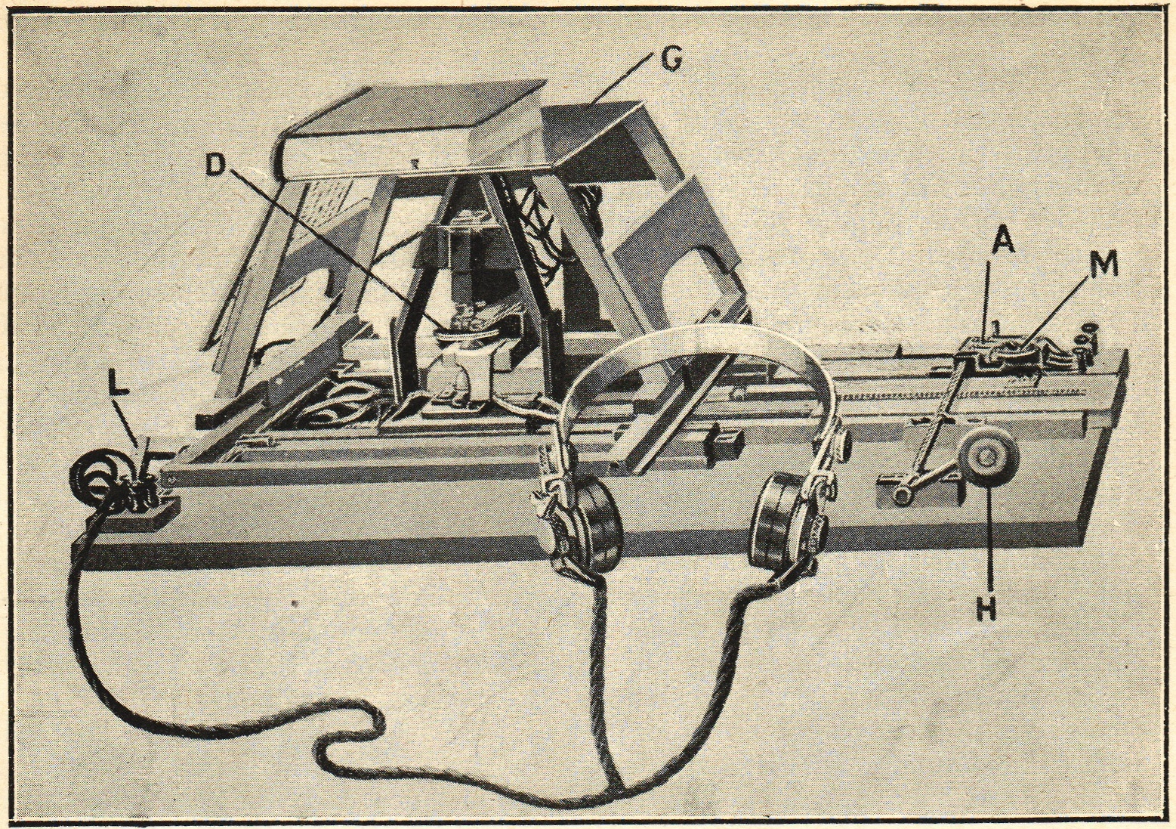
Timeline of OCR 1914
Emanuel Goldberg developed a machine that read characters and converts them into standard telegraph code.
This was the first OCR invention, the Optophone.

Slide 10
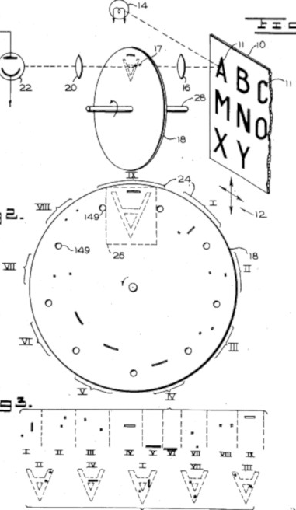
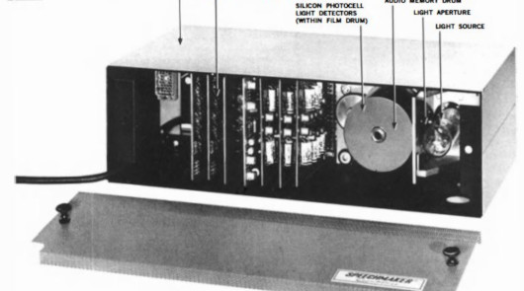
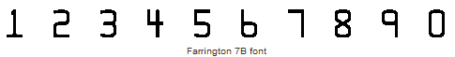
GIZMO 1952
Intelligent Machines Research Corporation, the first company to sell OCR tools.
A machine able to convert printed messages into machine language for processing by computer.

Slide 11
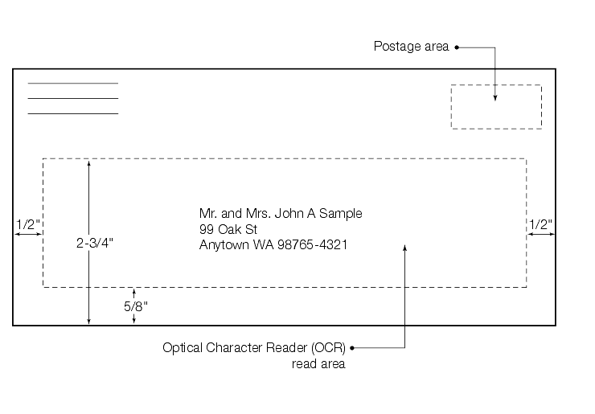
1971, First Postal Usage
A Canadian postal operator started using OCR systems to read the name and address on the envelopes and to print barcodes.

Slide 12
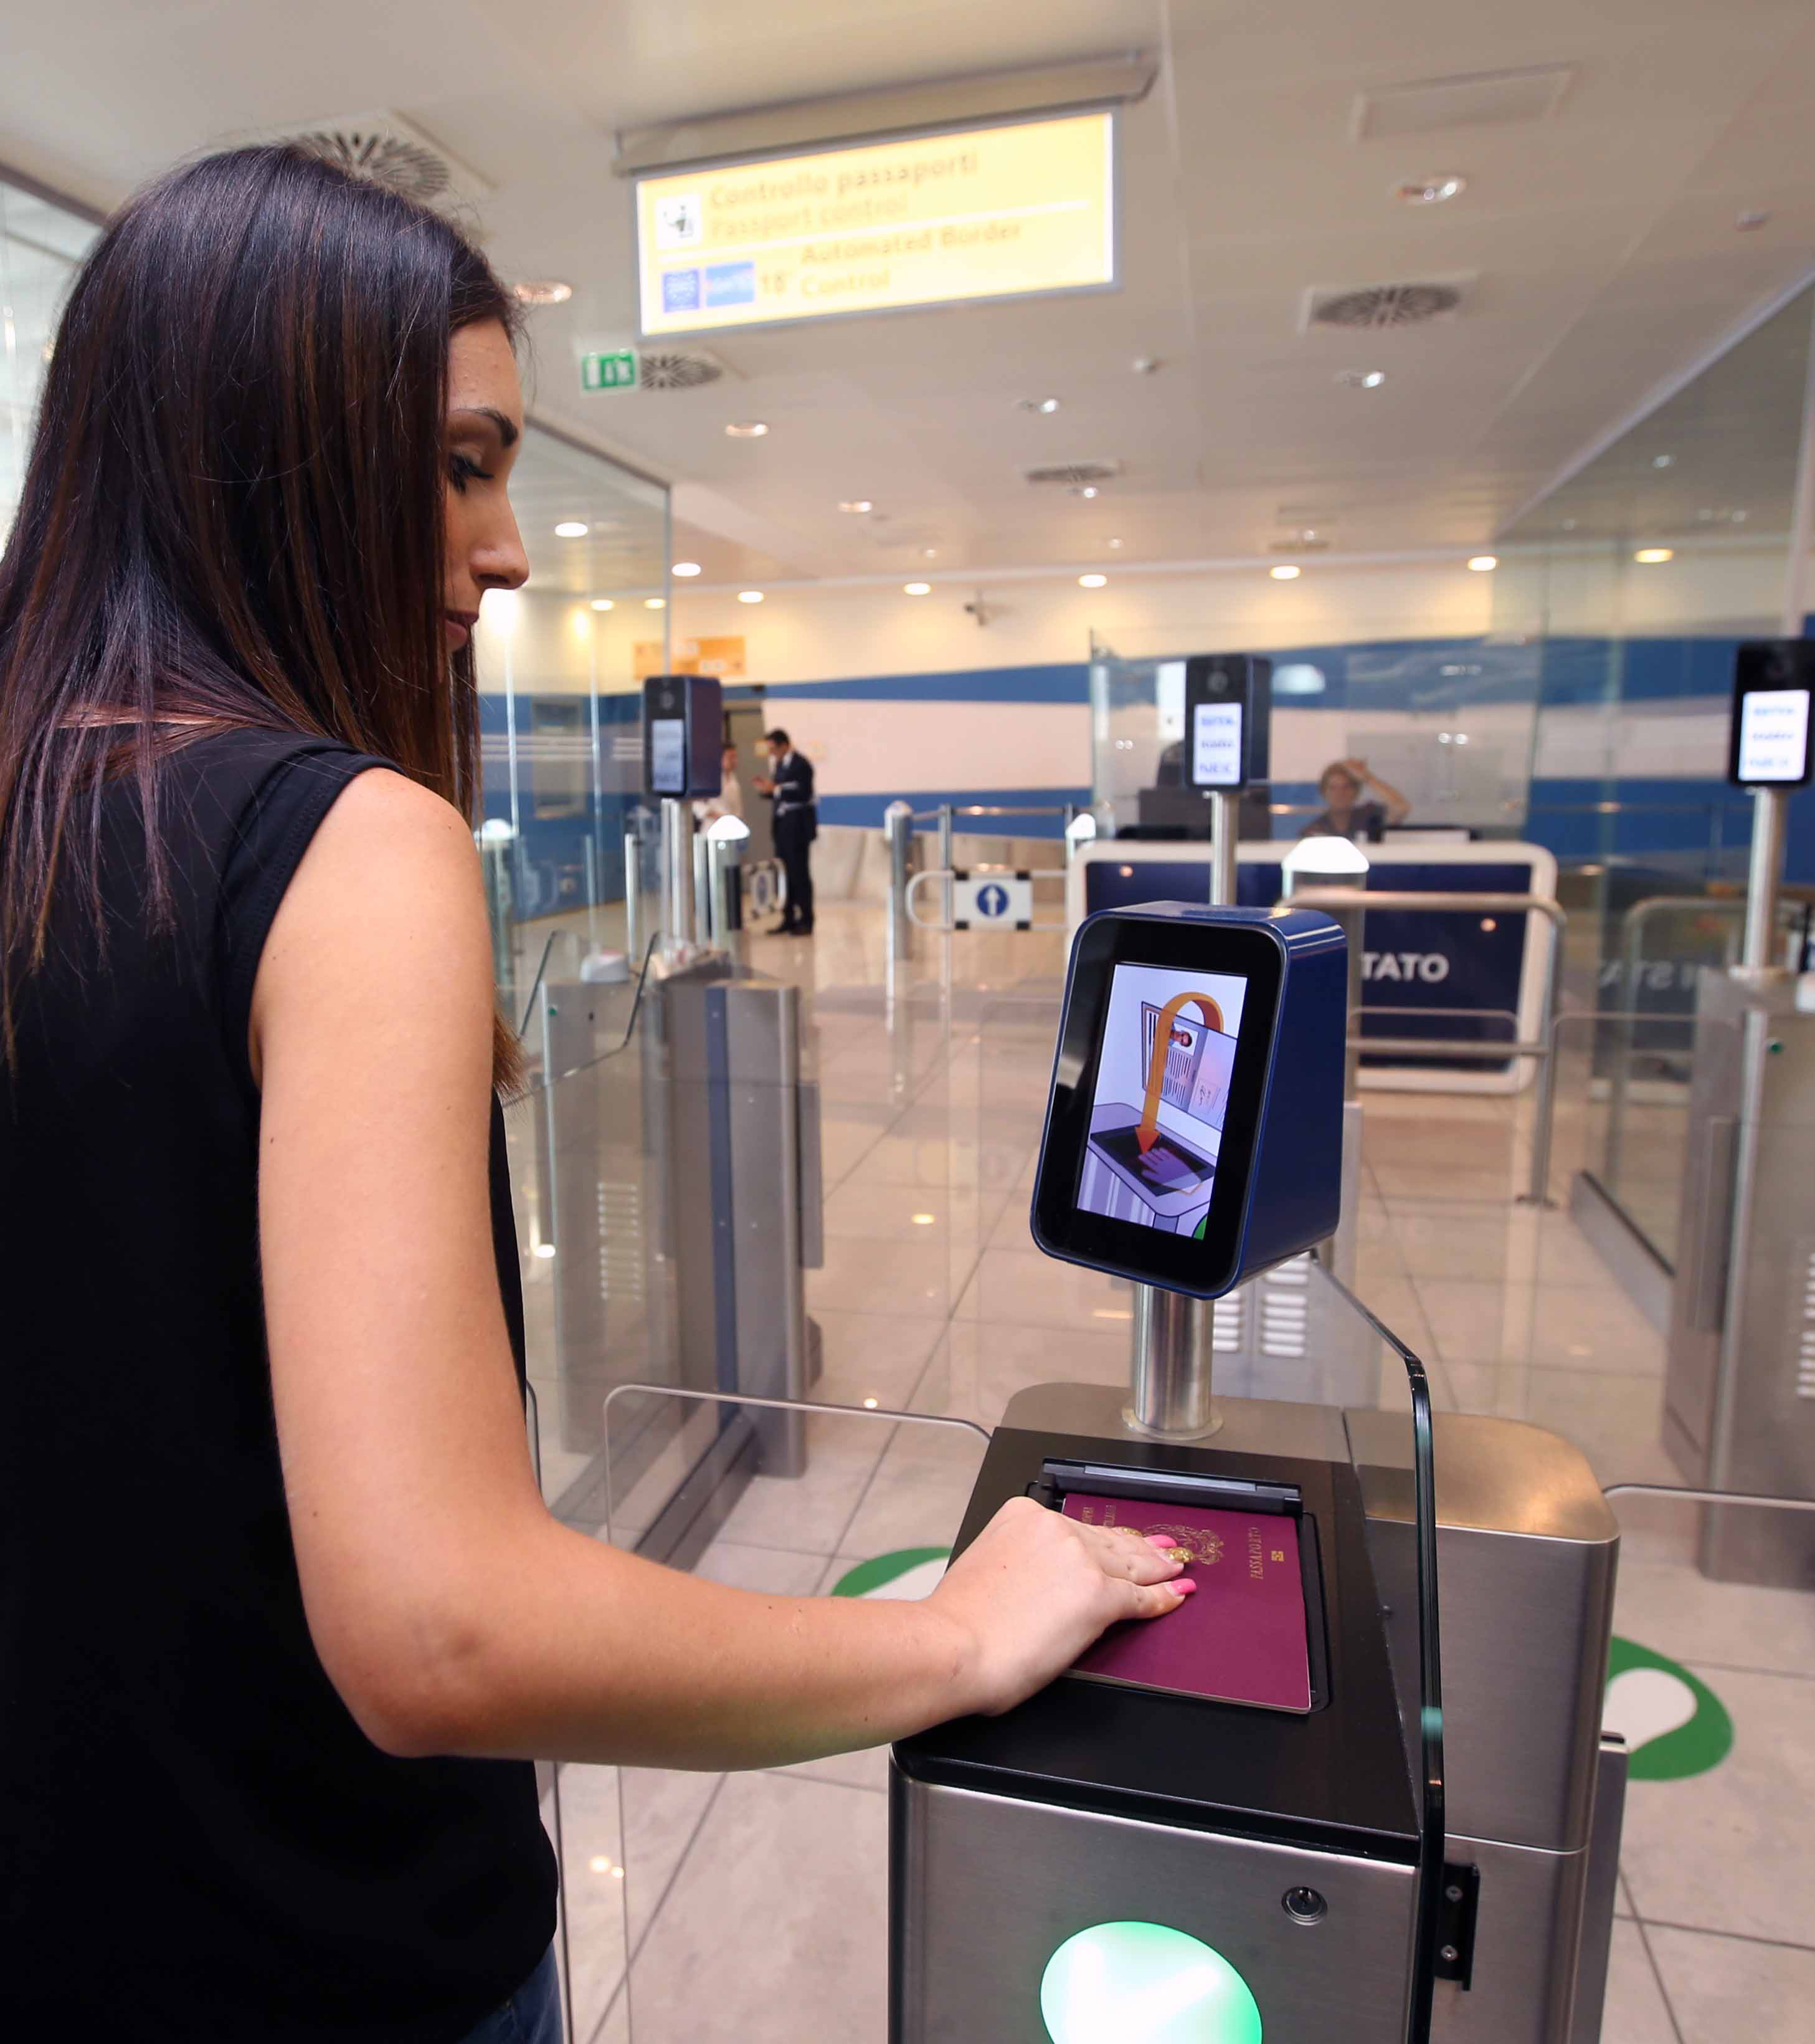
Passport recognition
Facial recognition to confirm the person is the passport holder.
Confirm the passport is valid, authentic, and is authorized to enter the country (fingerprints may be asked if unsure).

Slide 13
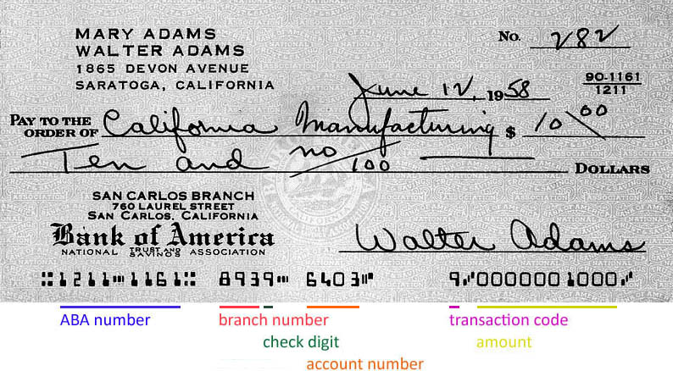
Handling checks in banks

Slide 14
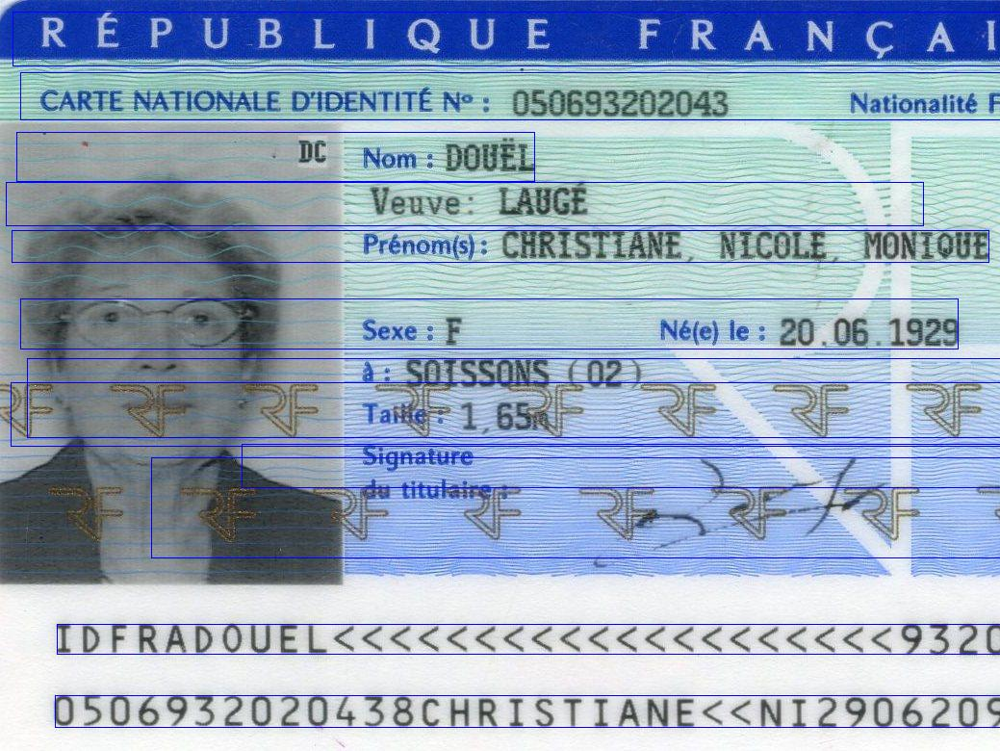
Identity Verification

Slide 15
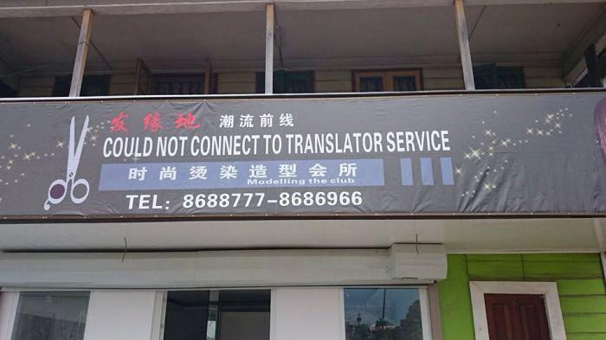
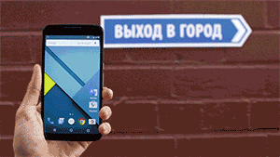
Google Translate

Slide 16
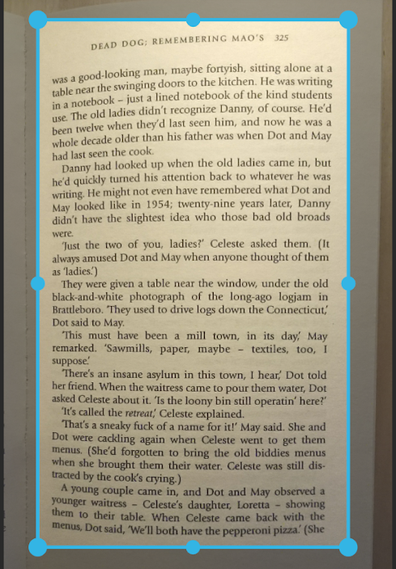
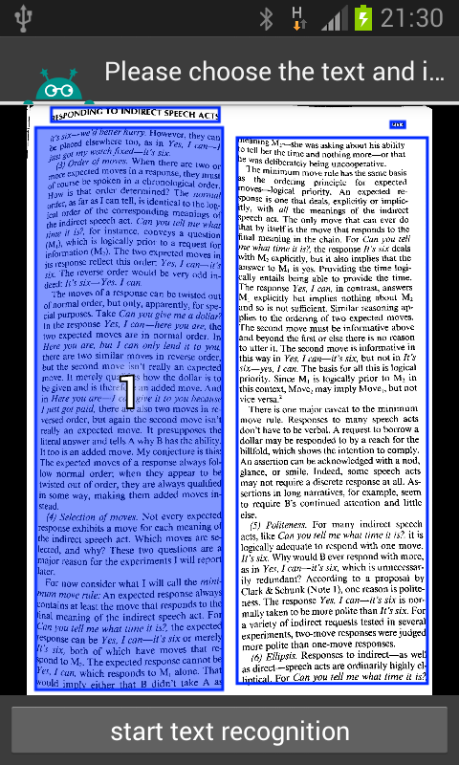
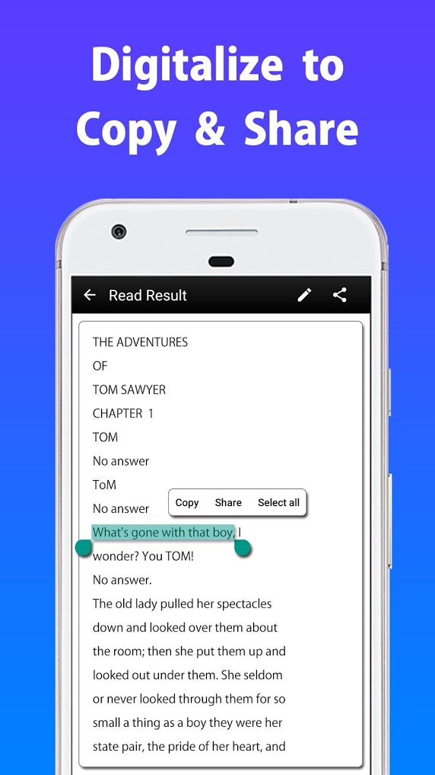
Text Recognition of documents

Slide 17
Sources
It’s over.
Optical Character Recognition, on Wikipedia.org https://en.wikipedia.org/wiki/Optical_character_recognition
What is OCR ? on Abby.com https://www.abbyy.com/en-gb/finereader/what-is-ocr/
Where is OCR used ? on Analyne.com https://anyline.com/news/where-is-ocr-used/
OCR Timeline https://en.wikipedia.org/wiki/Timeline_of_optical_character_recognition
Automatic plate recognition https://en.wikipedia.org/wiki/Automatic_number-plate_recognition
Pen Computing https://en.wikipedia.org/wiki/Pen_computing
First OCR System : “Gismo”, on historyofinformation.com http://www.historyofinformation.com/detail.php?entryid=885
ID card detection using Emgu and Tesseract OCR http://fireuprealknowledge.blogspot.com/2017/11/id-card-detection-using-emgu-and.html
SITA self service technology fast tracks immigration at Naples airport http://aerolatinnews.com/industria-aeronautica/sita-self-service-technology-fast-tracks-immigration/

Slide 18
Sources
Optical Character Recognition, on Wikipedia.org https://en.wikipedia.org/wiki/Optical_character_recognition
What is OCR ? on Abby.com https://www.abbyy.com/en-gb/finereader/what-is-ocr/
Where is OCR used ? on Analyne.com https://anyline.com/news/where-is-ocr-used/
OCR Timeline https://en.wikipedia.org/wiki/Timeline_of_optical_character_recognition
Automatic plate recognition https://en.wikipedia.org/wiki/Automatic_number-plate_recognition
Pen Computing https://en.wikipedia.org/wiki/Pen_computing
First OCR System : “Gismo”, on historyofinformation.com http://www.historyofinformation.com/detail.php?entryid=885
ID card detection using Emgu and Tesseract OCR http://fireuprealknowledge.blogspot.com/2017/11/id-card-detection-using-emgu-and.html
SITA self service technology fast tracks immigration at Naples airport http://aerolatinnews.com/industria-aeronautica/sita-self-service-technology-fast-tracks-immigration/

